Slide 1
Spam Filter
TheFrenchConnection

Slide 2
Our project
Discord Bot
Delete spam
Summarize conversation
Python3, nltk, discord
Java, JavaFX

Slide 3
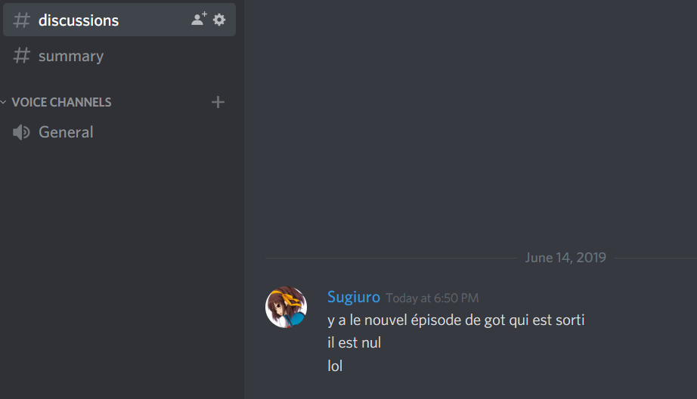
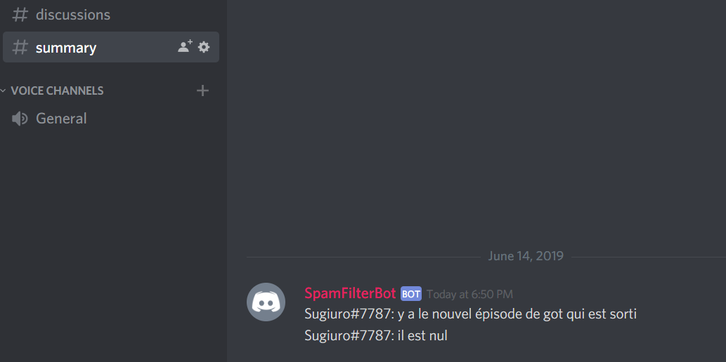
Example

Slide 4
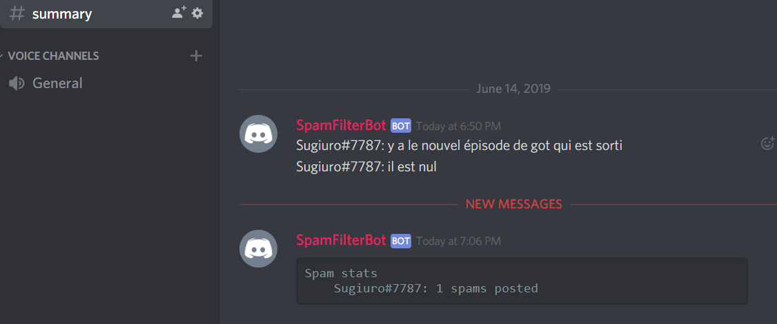
Example

Slide 5
How does it work ?
Database of spam messages
Compute vector
For each message, compute cosine similarity
Additional checks
Email, links => are never considered as spam
Length similarity

Slide 6
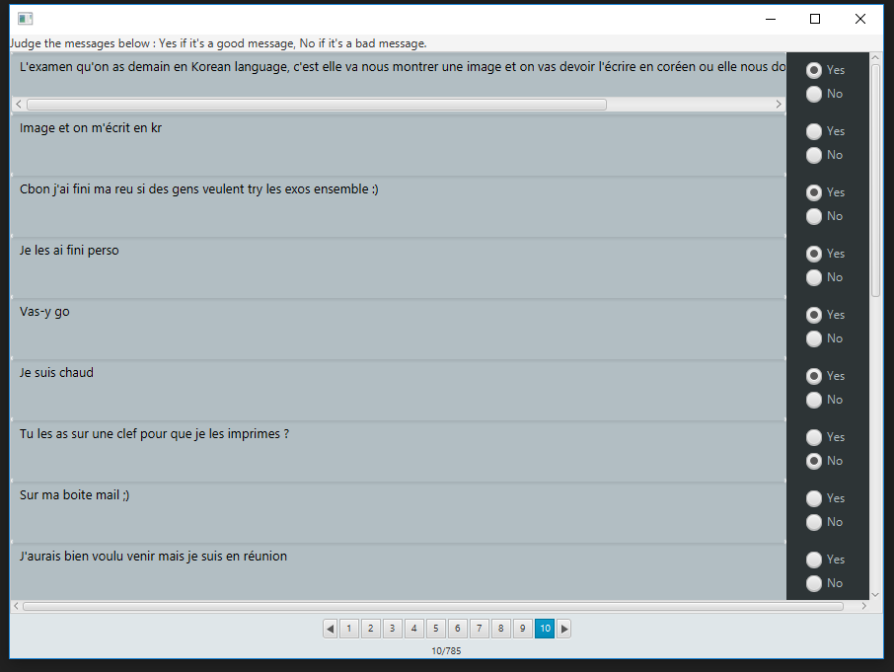
Build the database

Slide 7
What is (usually) considered a spam ?
Small messages
Aggressive messages (“shut up”, …)
Smileys
Text only smileys like “XD”

Slide 8
What is (usually) safe ?
Very long texts (usually arguments)
« Ok », « kk », « k », « Yeah », « yes », …
Questions (most of the time)

Slide 9
Weaknesses and choices
Permissive
Should NEVER mark a valid message as spam
Database dependant
A bad database = bad reactions

Slide 10
Any questions ?

